Slide 1
Theories of Motivation
Sessions(23-27)

Slide 2
What inspires employees to provide excellent service, market a company’s products effectively, or achieve the goals set for them?
Answering this question is of utmost importance if we are to understand and manage the work behavior of our peers and subordinates. Put a different way, if someone is not performing well, what could be the reason?

Slide 3
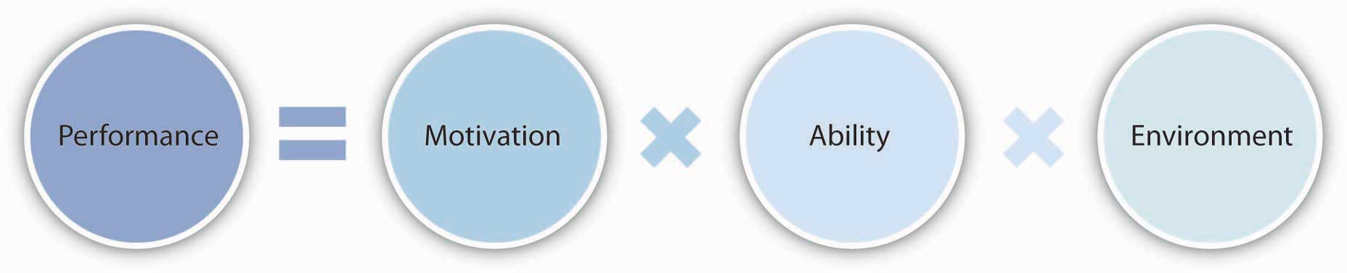

Slide 4
Why do some employees try to reach their targets and pursue excellence while others merely show up at work and count the hours? As with many questions involving human beings, the answer is anything but simple. Instead, there are several theories explaining the concept of motivation

Slide 5
Motivation
Motivation is one's direction to behavior, or what causes a person to want to repeat a behavior, a set of force that acts behind the motives. An individual's motivation may be inspired by others or events (extrinsic motivation) or it may come from within the individual (intrinsic motivation).

Slide 6
If you are intrinsically motivated, you do things by and for yourself without expecting a reward. It’s more about personal growth, sense of duty, while extrinsic motivation is more about financial incentives, status, and public recognition.
Some examples of Intrinsic motivation are:
Traveling because you want to explore different cultures
Cooking because you like trying new recipes
Helping other people without rewards because it makes you appreciate your life more
Reading a book because you enjoy the storytelling
Cleaning your home because it makes you feel clean

Slide 7
Some examples of extrinsic motivation are:
Going to work because you must earn money
Studying because you want to get a good grade
Helping others because you hope for praise from friends or family
Doing a certain work because you are looking for attention
Volunteering because it looks good on your resume

Slide 8
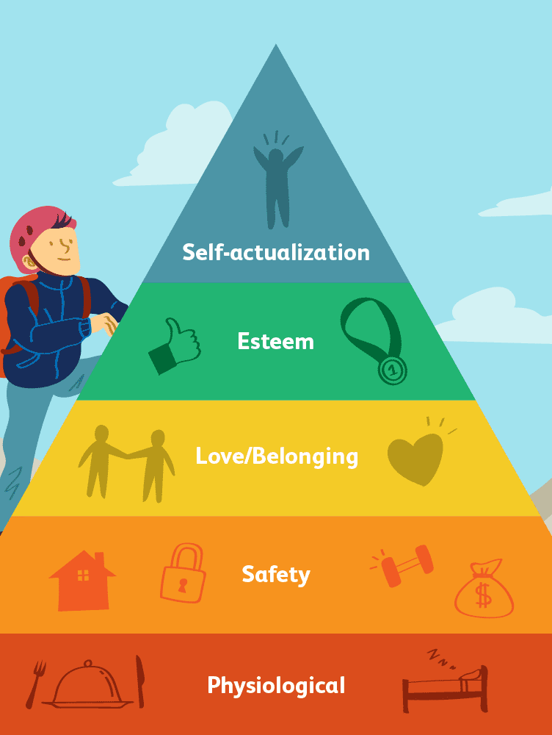
Maslow’s need hierarchy theory
Maslow's hierarchy of needs is a theory in psychology proposed by Abraham Maslow.

Slide 9
Mc Gregor’s Theory X and Theory Y
In the 1960s, social psychologist Douglas McGregor developed two contrasting theories that explained how managers' beliefs about what motivates their people can affect their management style. He labeled these Theory X and Theory Y.

Slide 10
Theory X
This style of management assumes that workers:
Dislike their work.
Avoid responsibility and need constant direction.
Have to be controlled, forced and threatened to deliver work.
Need to be supervised at every step.
Have no incentive to work or ambition, and therefore need to be enticed by rewards to achieve goals.

Slide 11
Theory Y
This style of management assumes that workers are:
Happy to work on their own initiative.
More involved in decision making.
Self-motivated to complete their tasks.
Enjoy taking ownership of their work.
Seek and accept responsibility, and need little direction.
View work as fulfilling and challenging.
Solve problems creatively and imaginatively.

Slide 12
Alderfer’s ERG theory
ERG theory, developed by Clayton Alderfer, is a modification of Maslow’s hierarchy of needs.

Slide 13
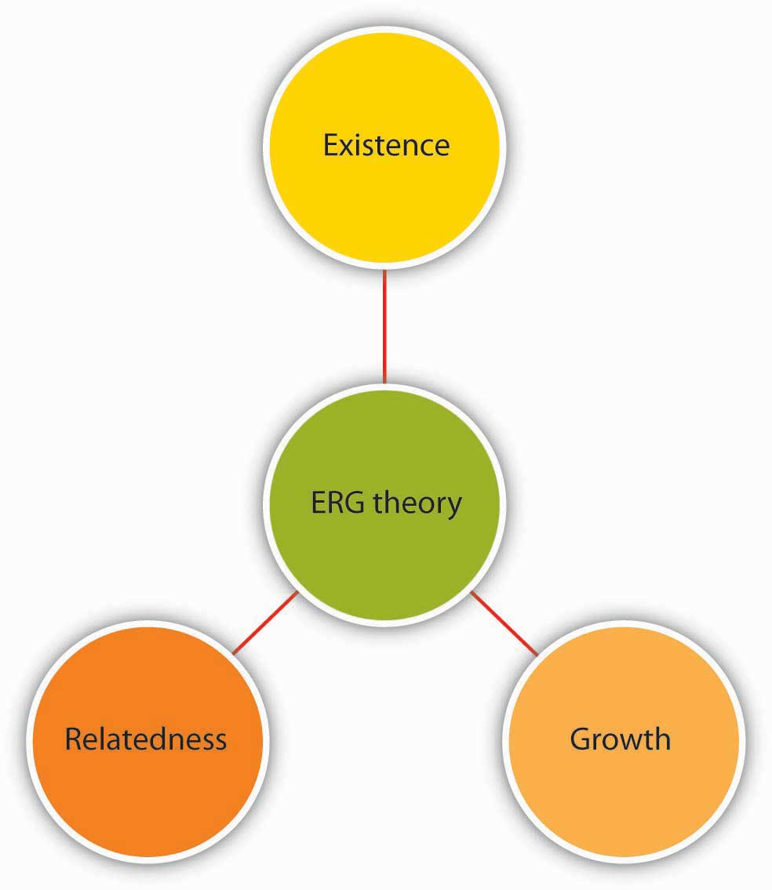

Slide 14
Herzberg’s two factor theory
Frederick Herzberg approached the question of motivation in a different way. By asking individuals what satisfies them on the job and what dissatisfies them, Herzberg came to the conclusion that aspects of the work environment that satisfy employees are very different from aspects that dissatisfy them.

Slide 15
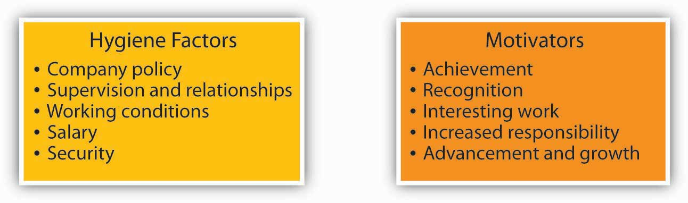

Slide 16
Vroom’s expectancy theory
Vroom's Expectancy Theory addresses motivation and management. The theory suggests that an individual's perceived view of an outcome will determine the level of motivation.
According to this theory, individuals ask themselves three questions.

Slide 17
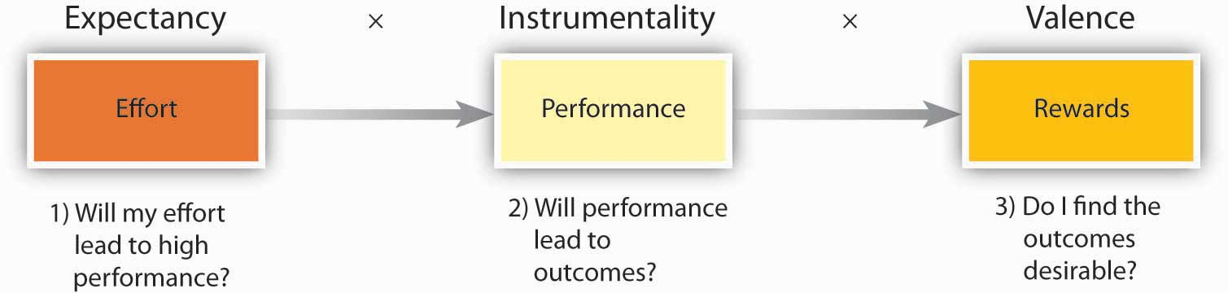
Motivation force

Slide 18
Let’s assume that a person is working in the concession stand of a movie theater. He was selling an average of 100 combos of popcorn and soft drinks a day. Now his manager asks him to increase this number to 300 combos a day. Would he be motivated to try to increase his numbers? Here is what he may be thinking:

Slide 19
Expectancy: Can I do it? If I try harder, can I really achieve this number? Is there a link between how hard I try and whether I reach this goal or not? If he feels that he can achieve this number if he tries, he has high expectancy.

Slide 20
Instrumentality: What is in it for me? What is going to happen if I reach 300? What are the outcomes that will follow? Are they going to give me a 2% pay raise? Am I going to be named the salesperson of the month? Am I going to receive verbal praise from my manager? If he believes that performing well is related to certain outcomes, instrumentality is high.

Slide 21
Valence: How do I feel about the outcomes in question? Do I feel that a 2% pay raise is desirable? Do I find being named the salesperson of the month attractive? Do I think that being praised by my manager is desirable? If your answers are yes, valence is positive. In contrast, if you find the outcomes undesirable (you definitely do not want to be named the salesperson of the month because your friends would make fun of you), valence is negative

Slide 22
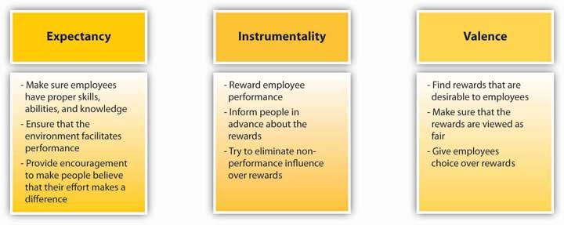
Ways in Which Managers Can Influence Expectancy, Instrumentality, and Valence

